Slide 1


Analyzing and Predicting Youth Substance Usage: Insights from Decision Tree Analysis
Presented By
LAVANYA BUNADRI

Slide 2
Project analysis slide 2
INTRODUCTION
This study into the dynamics of youth alcohol use through rigorous analysis using decision tree models on data from the National Survey on Drug Use and Health.
It addresses three key objectives: binary classification for alcohol use, multi-class classification for alcohol frequency in the past year, and regression to predict the age of first alcohol use.
By examining demographic variables and youth experiences, the study unveils crucial insights into the factors influencing alcohol consumption among young individuals.
These findings are instrumental in crafting targeted interventions and public health strategies to address and mitigate the challenges posed by alcohol use among the youth population.

Slide 3
THEORITICAL BACKGROUND
Model | Description | Implementation Approach | Hyperparameter Tuning | Evaluation Metrics | Interpretation
Decision Tree | Supervised learning model that splits data into branches based on feature values, creating a tree structure. | Build the tree by recursively splitting the data based on the best feature splits until stopping criteria are met. | Control tree depth, minimum number of samples per split, pruning strategies. | Accuracy, confusion matrix, error rate, Mean Squared Error (MSE) for regression tasks. | Easy to interpret and visualize but may overfit if the tree grows too deep without pruning.
Bagging | Ensemble method that combines multiple models trained on different random subsets of the data. | Train multiple models on bootstrap samples, then aggregate their predictions through majority voting classification or averaging regression. | Number of trees, sample size, aggregation method. | Accuracy, Out-of-Bag (OOB) error estimate, variable importance measures. | Reduces variance and overfitting by averaging multiple models, leading to more stable predictions.
Random Forest | Advanced ensemble technique that improves Bagging by adding random feature selection at each split, reducing tree correlation. | Train an ensemble of decision trees on bootstrap samples with random subsets of features chosen at each split. | Number of trees, number of features considered at each split (mtry), tree depth, sample size. | Accuracy, OOB error, confusion matrix, variable importance (Gini or %IncMSE). | More robust and accurate than a single tree, effectively handles large datasets and high-dimensional features.

Slide 4
Project analysis slide 2
METHODOLOGY
1.Data Preparation :
-The analysis utilized the National Survey on Drug Use and Health (NSDUH) youth dataset.
-Missing values were removed using the `na.omit()` function to ensure data quality.
-The dataset was split into 70% training and 30% testing sets to evaluate model performance effectively.
2.Variable Selection :The features were grouped into two major categories:
Demographic Variables (`demographic_cols`):
- Age, Gender, Race, Income, Education, etc.
Youth Experience Variables (`youth_experience_cols`):
- Peer influence, parental involvement, mental health, substance exposure, school performance.
3.Target Variables and Problem Definitions
Binary Classification:
- Target: `alcflag` (0 = Never used alcohol, 1 = Ever used alcohol).
- Goal: Predict whether a youth has ever consumed alcohol.
Multi-Class Classification:
- Target: `alcydays` (Frequency of alcohol use in the past year).
- Goal: Predict the usage frequency category.
Regression:
- Target: `iralcage` (Age of first alcohol use).
- Goal: Estimate the age at which alcohol use began.

Slide 5
Project analysis slide 2
METHODOLOGY
4. Model Development
Decision Trees
Bagging
Random Forests
5. Model Evaluation
Classification tasks (Binary and Multi-Class): Evaluated using accuracy, confusion matrices, and class distribution checks.
Regression task: Evaluated using Mean Squared Error (MSE).
6. Model Tuning and Validation
Hyperparameters for each model were optimized through cross-validation to avoid overfitting and improve generalization.
Comparisons were made across models to identify the best-performing approach for each task.

Slide 6
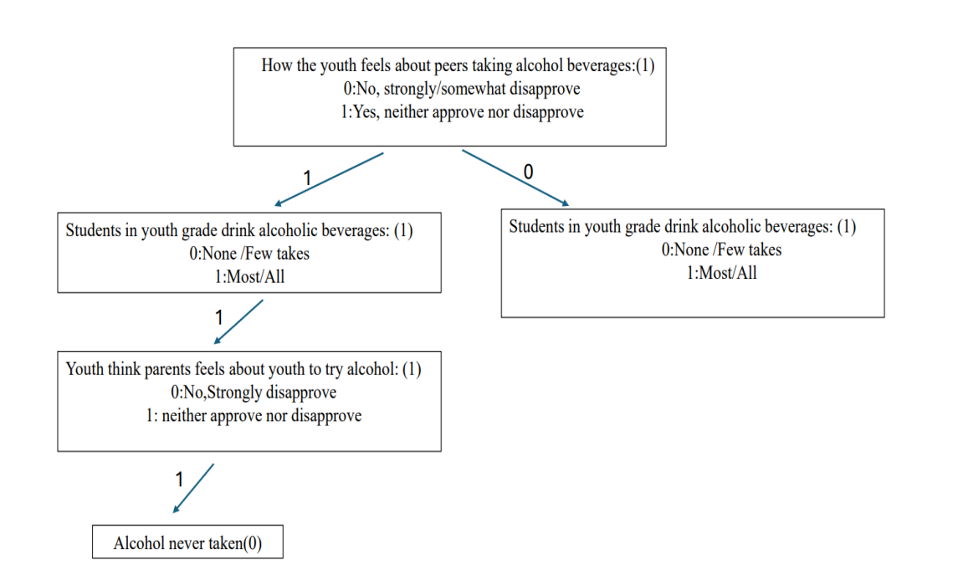
Project analysis slide 2
RESULTS
The tree predicts whether a youth has ever consumed alcohol (Yes = 1, No = 0).
Root Node: Evaluates how the youth feels about peers drinking alcohol:
1 = Neither approve nor disapprove → goes to left branch
0 = Strongly/somewhat disapprove → goes to right branch
Left Branch: Checks if most/all students in their grade drink alcohol:
1 = Yes → moves further
0 = No → ends with prediction
If most/all students drink, the model asks:
How the youth thinks parents feel about them trying alcohol
1 = Neither approve nor disapprove
leads to prediction: Alcohol never taken (0)
Insight:
Even when surrounded by peer alcohol use, lack of strong parental disapproval correlates with non-use.
Highlights the complex interaction between peer influence and parental attitudes.
Binary Classification-Alcohol Use
Decision Tree Flow

Slide 7
Project analysis slide 2
BINARY CLASSIFICATION
Performance Evaluation
Initial Decision Tree (Before Pruning)
Pruned Decision Tree
 | Actual Yes (Ever Used Alcohol) | Actual No (Never Used Alcohol)
Predicted Yes | 127 | 34
Predicted No | 219 | 901
 | Actual Yes (Ever Used Alcohol) | Actual No (Never Used Alcohol)
Predicted Yes | 127 | 34
Predicted No | 219 | 901
The accuracy of initial decision tree: 0.802498
The accuracy of pruned decision tree: 0.802498
Improving Performance with Ensemble Methods: Bagging
mtry = 7-1
OOB estimate of error rate: 19.71%
The accuracy of the Bagging model: 0.8056206
Confusion Matrix on Testing Data
 | Actual Yes (Ever Used Alcohol) | Actual No (Never Used Alcohol)
Predicted Yes | 190 | 93
Predicted No | 156 | 842

Slide 8
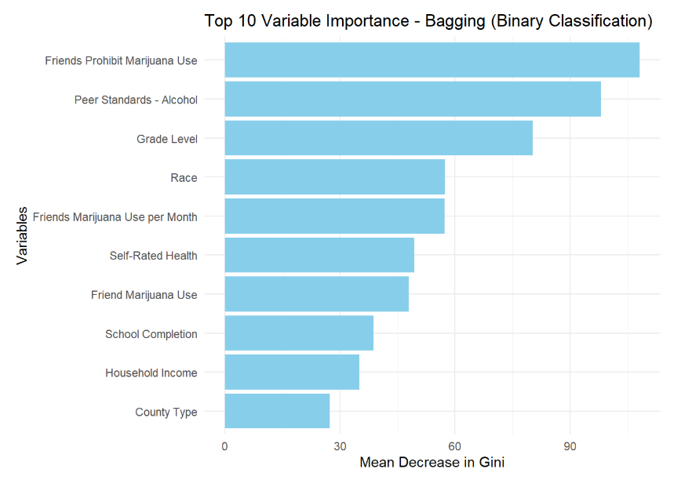
Project analysis slide 2
BINARY CLASSIFICATION
Important Variables - Bagging

Slide 9
Project analysis slide 2
BINARY CLASSIFICATION
Ensemble Methods - Random Forest
mtry parameter was set to the square root of the number of predictors.
number of trees ntree was set to 5000.
OOB estimate of error rate: 19.24%
Confusion matrix on training data
Confusion Matrix on Testing Data
 | Actual Yes (Ever Used Alcohol) | Actual No (Never Used Alcohol) | Class.error
Predicted Yes | 380 | 429 | 0.53028430
Predicted No | 146 | 2033 | 0.06700321
 | Actual Yes (Ever Used Alcohol) | Actual No (Never Used Alcohol)
Predicted Yes | 172 | 64
Predicted No | 174 | 871
Accuracy of Random Forest Model: 0.8142077

Slide 10
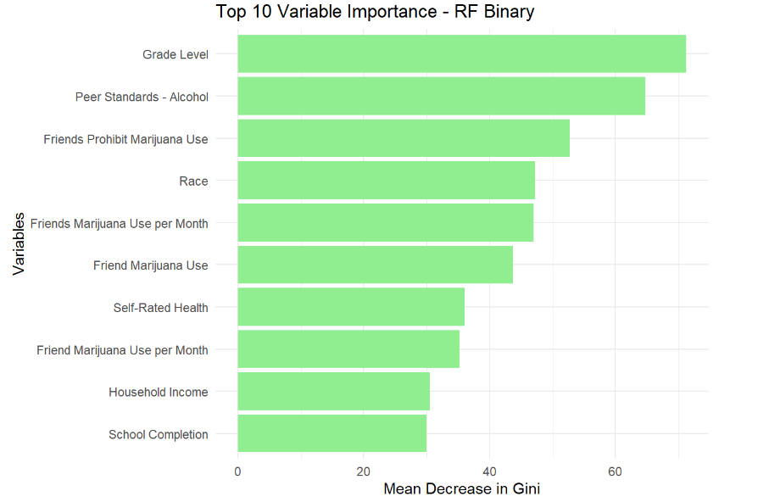
Project analysis slide 2
BINARY CLASSIFICATION
Important Variables - Random Forest

Slide 11
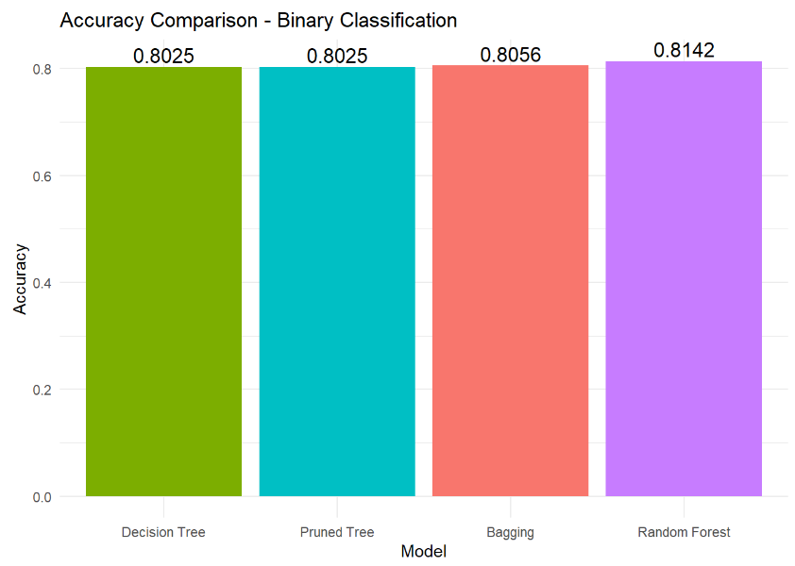
Project analysis slide 2
BINARY CLASSIFICATION
Summary of Model Performance

Slide 12
Comparison of Ensemble Methods – Binary Classification
Feature | Bagging | Random Forests
Number of Trees | 500 trees | 5000 trees
Predictors at Each Split | mtry =P-1 | mtry = sqrt(P)
Key Tuning Parameters | mtry=P-1, n.tree = 500 | mtry = sqrt(P),n.tree = 5000
Observations per Model | Bootstrap samples (size roughly 70% of training data) | Bootstrap samples (size roughly 70% of training data)
Overfitting | Less overfitting (OOB error = 19.71%) | Less overfitting (OOB error = 19.24%)
Accuracy on Test Set | 0.8056 | 0.8142

Slide 13
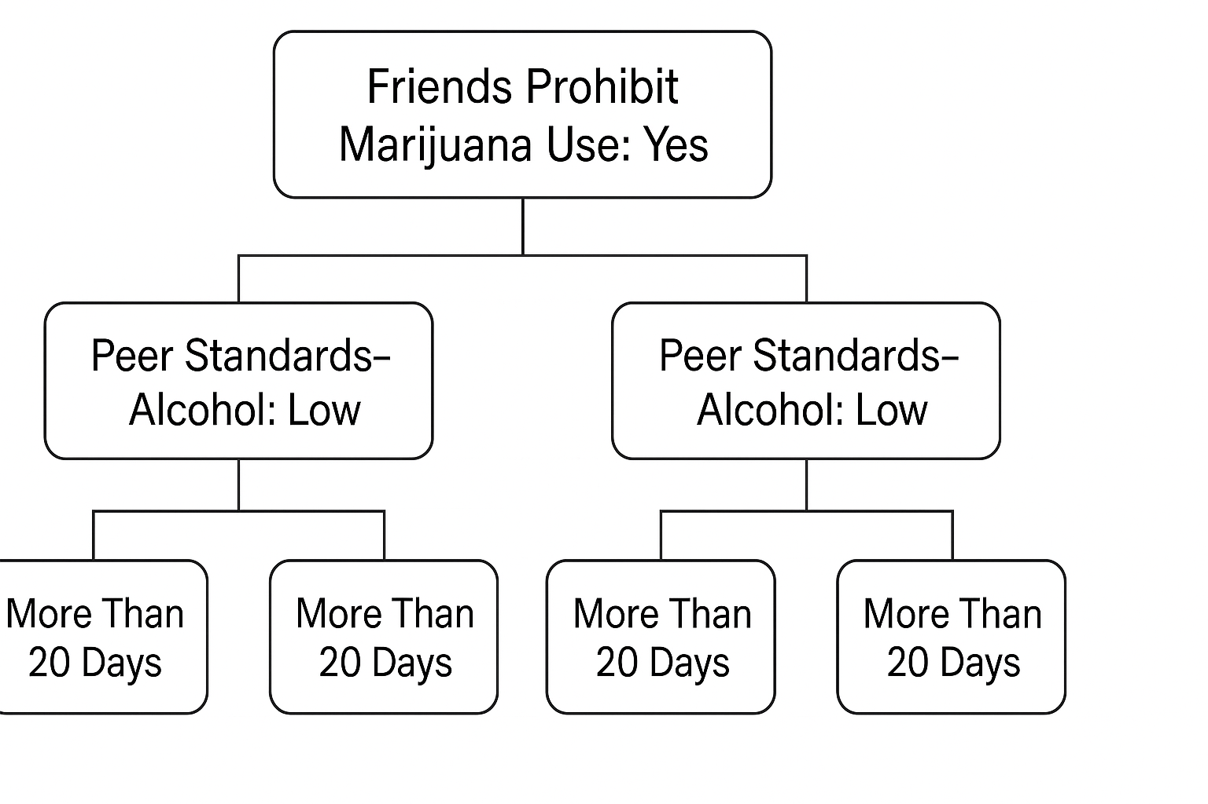
Project analysis slide 2
Multi class Classification
Multi-Class Classification of Alcohol Use Frequency
Pruned Decision Tree

Slide 14
Project analysis slide 2
Multi class Classification
Performance Evaluation
Confusion Matrix-Initial Multi-Class Decision Tree (Before and After Pruning)
Predicted / Actual | Never Used | 1-2 Days | 3-5 Days | 6-10 Days | 11-20 Days | More Than 20 Days
Never Used | 0 | 0 | 0 | 0 | 0 | 0
1-2 Days | 0 | 0 | 0 | 0 | 0 | 0
3-5 Days | 0 | 0 | 0 | 0 | 0 | 0
6-10 Days | 0 | 0 | 0 | 0 | 0 | 0
11-20 Days | 0 | 0 | 0 | 0 | 0 | 0
More Than 20 Days | 160 | 81 | 27 | 19 | 0 | 994
The overall accuracy: 0.7759563
The accuracy of the pruned tree: 0.7759563

Slide 15
Project analysis slide 2
Multi class Classification
Ensemble Method: Bagging
Predicted / Actual | Never Used | 1-2 Days | 3-5 Days | 6-10 Days | 11-20 Days | More Than 20 Days
Never Used | 24 | 25 | 8 | 5 | 0 | 34
1-2 Days | 13 | 7 | 7 | 3 | 0 | 5
3-5 Days | 0 | 0 | 0 | 1 | 0 | 0
6-10 Days | 0 | 0 | 0 | 1 | 0 | 1
11-20 Days | 0 | 0 | 0 | 0 | 0 | 0
More Than 20 Days | 123 | 49 | 12 | 9 | 0 | 954
Accuracy of Bagging Model:0.7697112

Slide 16
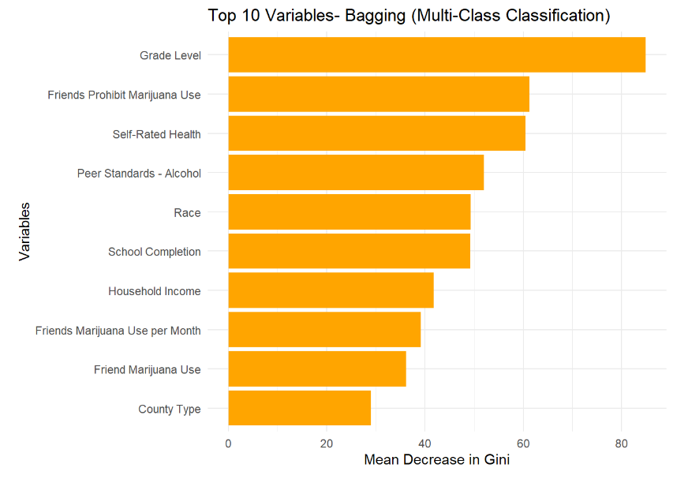
Project analysis slide 2
Multi class Classification
Important Variables - Bagging

Slide 17
Project analysis slide 2
Multi class Classification
Ensemble Method: Random Forest
Predicted / Actual | Never Used | 1-2 Days | 3-5 Days | 6-10 Days | 11-20 Days | More Than 20 Days
Never Used | 23 | 18 | 10 | 4 | 0 | 12
1-2 Days | 0 | 1 | 1 | 0 | 0 | 2
3-5 Days | 0 | 0 | 0 | 0 | 0 | 0
6-10 Days | 0 | 0 | 0 | 0 | 0 | 0
11-20 Days | 0 | 0 | 0 | 0 | 0 | 0
More Than 20 Days | 137 | 62 | 16 | 15 | 0 | 980
Mtry RF Tuning <- 2, 4, 6, 8, 10, 12, 15
Accuracy of Random Forest Model: 0.7837627

Slide 18
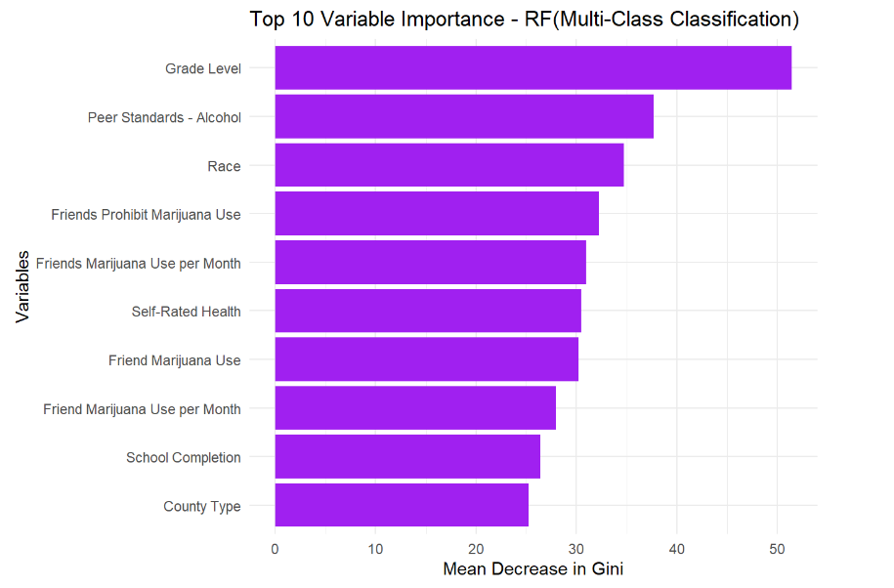
Project analysis slide 2
Multi class Classification
Important Variables – Random Forest

Slide 19
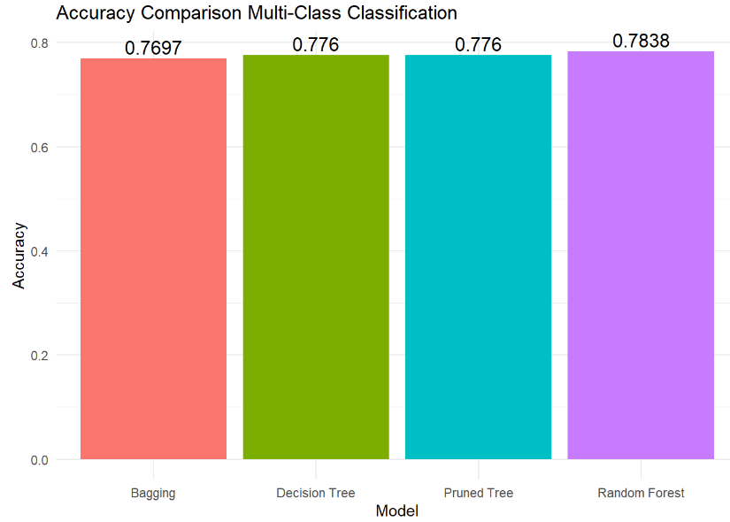
Project analysis slide 2
Multi class Classification
Summary of Model Performance

Slide 20
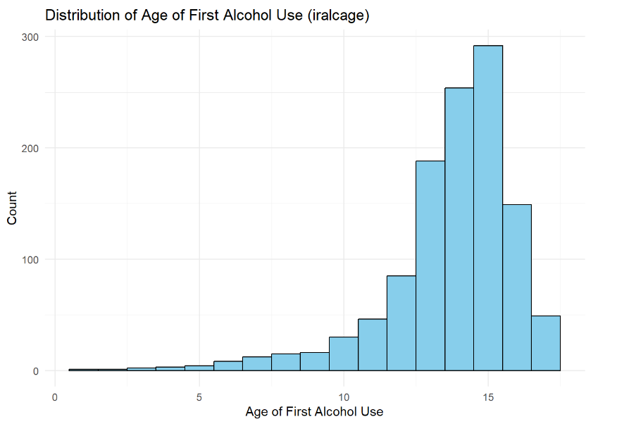
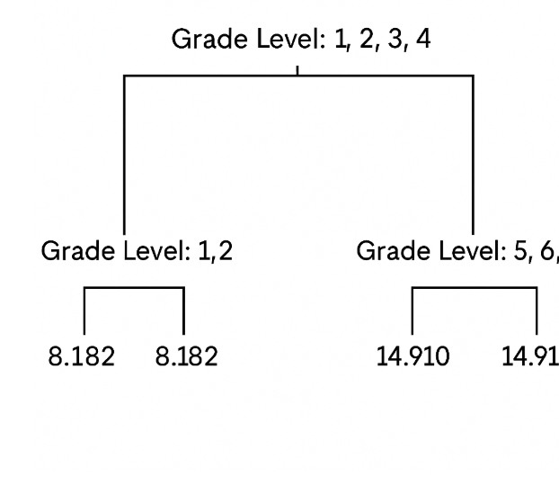
Project analysis slide 2
Regression
Predicting Age of First Alcohol Use
Pruned Decision Tree Flow

Slide 21
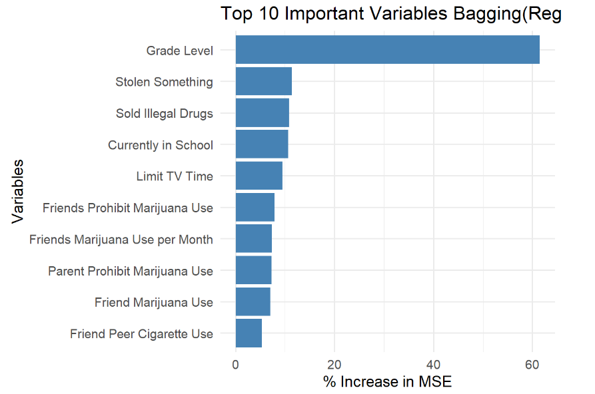
Project analysis slide 2
Regression
Performance Evaluation - Initial Regression Tree
Important Variables - Bagging
Model | Testing MSE
Regression Tree | 3.9398
Pruned Regression Tree | 3.6866
Ensemble Method: Bagging
Model | Training MSE | Testing MSE
Bagging (Regression) | 3.8429 | 3.9271

Slide 22
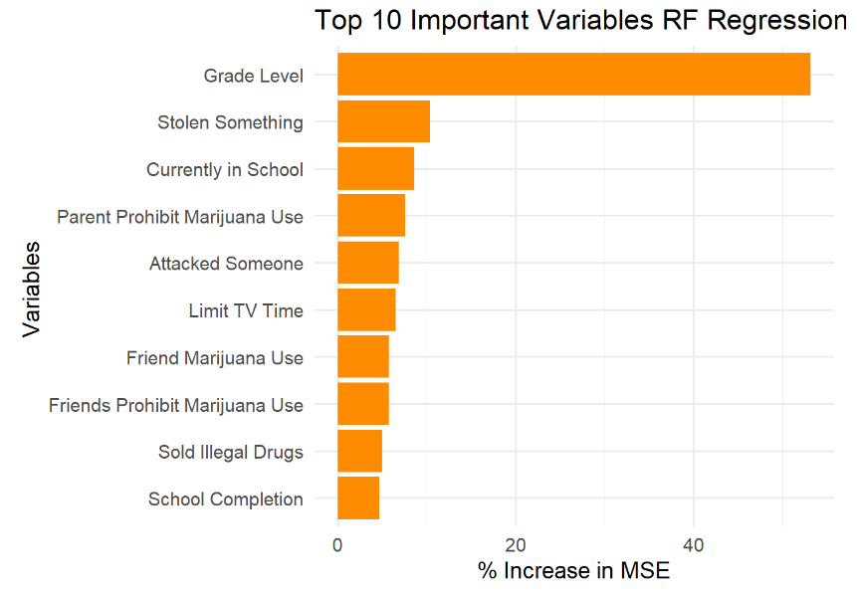
Project analysis slide 2
Regression
Ensemble Method: Random Forest
Important Variables - Random Forest
Model | Training MSE | Testing MSE
Random Forest (Regression) | 3.6010 | 3.6449

Slide 23
Project analysis slide 2
DISCUSSION
Binary Classification – Model Performance
Accuracy Isn’t Everything – Error Analysis
Metric | Decision Tree | Pruned Tree | Bagging | Random Forest
Accuracy | 0.8025 | 0.8025 | 0.8056 | 0.8142
Error Rate (1 - Accuracy) | 0.1975 | 0.1975 | 0.1944 | 0.1858
Class Balance in Test Data:
Yes (Alcohol Use): 27%
No (No Alcohol Use): 73%
 | Actual Yes | Actual No
Predicted Yes | 172 | 64
Predicted No | 174 | 871
False Negatives -174 youth with alcohol use misclassified as No.
Random Forest achieved the best accuracy.
Pruning the tree reduced complexity but not error rate.
Ensemble models outperformed the single decision tree.

Slide 24
Project analysis slide 2
DISCUSSION
Top Predictors of Bagging and Random Forest
Friends Prohibit Marijuana Use
Peer Standards for Alcohol
Friend Marijuana Use
Peer influence strongly associated with alcohol use.
Parental monitoring features also relevant in some models
Model Limitations:
High false negatives – risk of missing at-risk youth.
Class imbalance affects model learning.
Limited to survey-based features
Future Improvements:
Addressing class imbalance using re-weighting techniques.
By applying robust hyperparameter tuning for better model optimization.

Slide 25
Project analysis slide 2
DISCUSSION
Multi Class Classification – Model Performance
Metric | Decision Tree | Pruned Tree | Bagging | Random Forest
Accuracy | 77.60% | 77.60% | 76.97% | 78.38%
Error Rate | 22.40% | 22.40% | 23.03% | 21.62%
Highly Imbalanced where 78% in "More Than 20 Days“
Random Forest achieved the highest accuracy at 78.38%.
Pruning did not improve Decision Tree accuracy.
Bagging and Random Forest-ensemble models, performed slightly better than the single Decision Tree
Class Imbalance Error:
Top Predictors of Bagging and Random Forest
More Than 20 Days" is 78%
All other classes are minority.
peer and friend’s influences in alcohol use frequency is involved.
Friends Marijuana Use.
Average Grade.
school performance and parental monitoring

Slide 26
Project analysis slide 2
DISCUSSION
Regression– Model Performance
Metric | Decision Tree | Pruned Tree | Bagging | Random Forest
Training MSE | 3.9398 | 3.6866 | 3.8429 | 3.6010
Testing MSE | 3.9398 | 3.6866 | 3.9271 | 3.6449
Random Forest achieved the lowest MSE on both training and testing data, with the highest percentage of variance i.e. 32.07%.
Pruning improved the Decision Tree by slightly reducing MSE.
Bagging and Random Forest of ensemble methods outperformed the by regression tree.
Model Limitations:
Moderate variance of 32% suggests other unmeasured factors may influence age at first alcohol use.
Possible overfitting risk in decision tree without pruning.
Predictors have nonlinear relationships not fully captured by simpler trees.
Future Improvements:
Implement hyperparameter tuning with more mtry and ntree.
Considering better feature selection to reduce noise and improve interpretability.
Adding interaction terms or nonlinear transformations for better modeling.

Slide 27
Project analysis slide 2
Conclusion
Random Forest performed best for binary classification of alcohol use by Yes or No by achieving an accuracy of approximately 81%, indicating its effectiveness in identifying youth alcohol users.
Key predictors across models included grade level, peer influence, family environment, income, and youth risk behaviors are consistently emerging as important factors associated with alcohol use.
By analyzing alcohol use through binary using or not, ordinal of frequency of usage , and numeric the age at first use perspectives, the study provides flexible modeling approaches aligned with different prevention.
These findings offers valuable insights for health professionals, educators, and policymakers to identify at-risk youth and implement more targeted, data-informed to help young people stay healthier and safer.
Limitations such as class imbalance and restricted feature interactions may have influenced model performance.
Future work should consider the class balancing techniques ,hyperparameter tuning, and the inclusion of additional risk factors to enhance prediction accuracy.

Slide 28
Thank You

